Slide 1

Course Code: CSE 299 Section: 04 Project Group: 05 Group Members: Rishat Bin Sultan (2312559042) MD Tamim Hasan (2232239642) Fariha Islam (2311101642)
Group 05 | Rishat Bin Sultan, MD Tamim Hasan, Fariha Islam

Slide 2
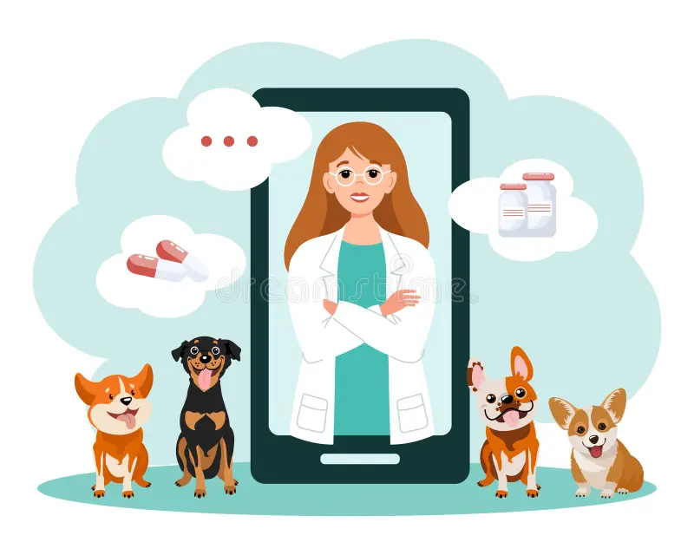
Smart Veterinary Care System with AI-Based Disease Detection
Group 05 | Rishat Bin Sultan, MD Tamim Hasan, Fariha Islam

Slide 3

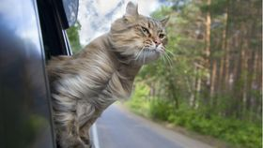

Problem Statement
Limited access to veterinary services (distance, time constraints)
Delay in identifying common pet diseases
Difficulty obtaining veterinary products quickly
Existing platforms lack intelligent health-support features
Group 05 | Rishat Bin Sultan, MD Tamim Hasan, Fariha Islam

Slide 4


Proposed Solution
Online veterinary e-commerce system
AI-based disease detection (image/symptom based)
Centralized system for users, admin, and delivery
24/7 online veterinary consultation if further treatment needed
Goal: Improve accessibility, awareness, and convenience
Group 05 | Rishat Bin Sultan, MD Tamim Hasan, Fariha Islam

Slide 5
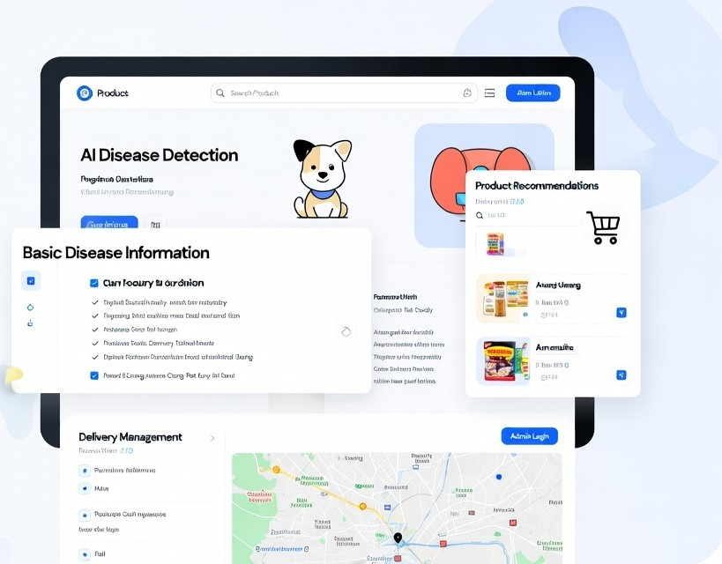
Project objectives
Develop a user-friendly online veterinary shop
Provide AI-based preliminary disease detection
Offer basic disease information and precautions
Integrate product recommendations with disease results
Ensure efficient admin and delivery management
Faster communication between vets and owners
Provide 24 hours online vet consultation support
Group 05 | Rishat Bin Sultan, MD Tamim Hasan, Fariha Islam

Slide 6

Target users
Veterinarians
Animal Owners
Clinic Administrators
Volunteers who rescuing animals
Group 05 | Rishat Bin Sultan, MD Tamim Hasan, Fariha Islam

Slide 7
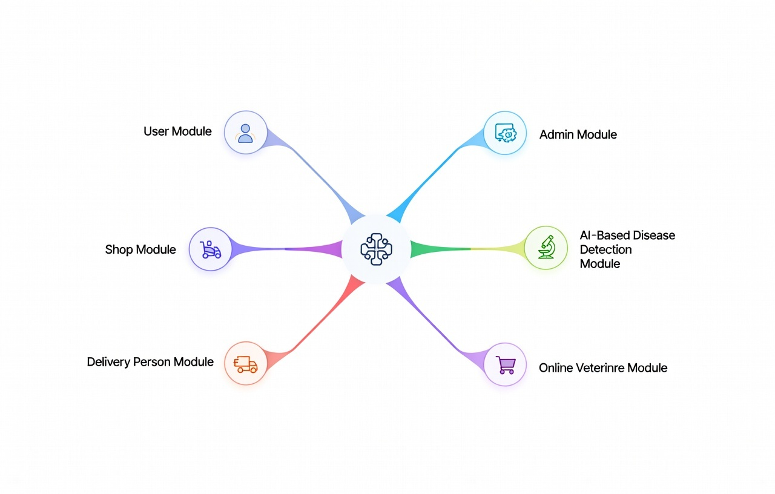
System Key Features
User Panel
Online Veterinary Shop Interface
AI-Based Disease Detection
Admin Dashboard
Product Delivery Portal
Health Records
24/7 Online Vet Consultation (Live chat or appointment system)
Group 05 | Rishat Bin Sultan, MD Tamim Hasan, Fariha Islam

Slide 8
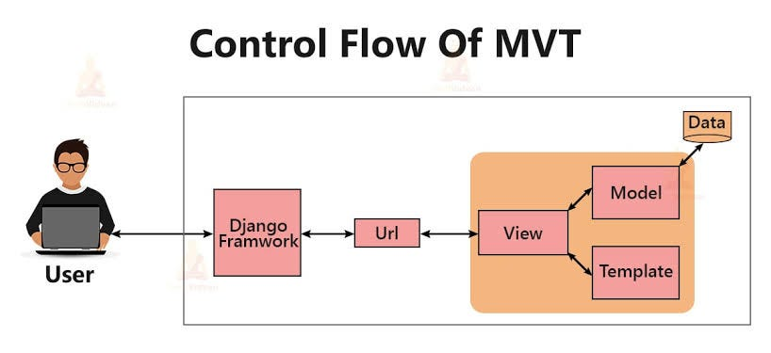
System Architecture
Three-tier architecture
Presentation Layer: Web Interface
Application Layer: Django Backend + AI Model
Data Layer: Relational Database
Group 05 | Rishat Bin Sultan, MD Tamim Hasan, Fariha Islam

Slide 9
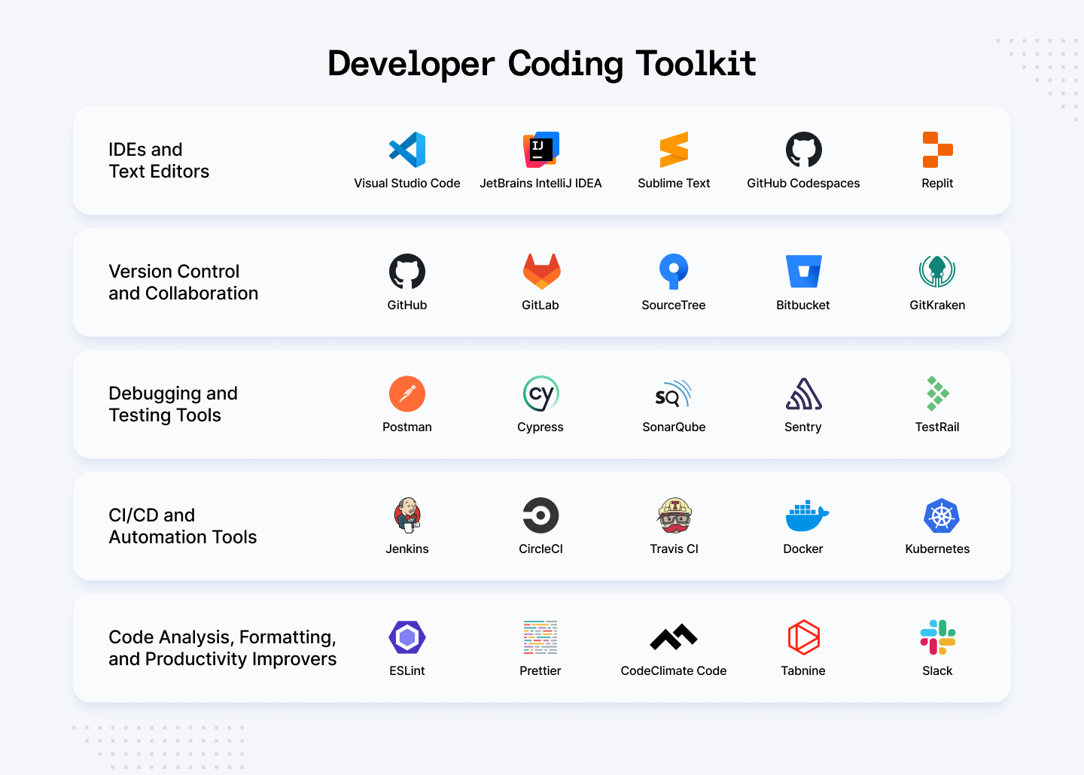
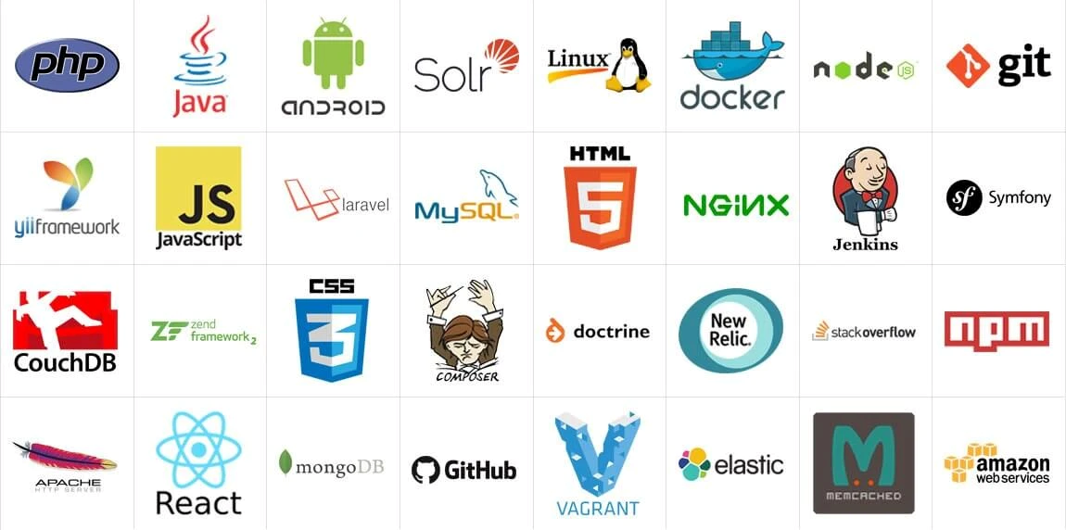
Tools & Technologies
Backend: Python, Django
Frontend: HTML, CSS, Bootstrap
Database: SQLite / MySQL
Machine Learning: scikit-learn / basic DL
Tools: VS Code, Web Browser
Group 05 | Rishat Bin Sultan, MD Tamim Hasan, Fariha Islam

Slide 10

Expected Outcomes
Functional online veterinary shop
AI-supported early disease awareness
User friendly Interface
Minimal paper work
Continuous veterinary support anytime, anywhere
Group 05 | Rishat Bin Sultan, MD Tamim Hasan, Fariha Islam

Slide 11

Conclusion
Combines e-commerce with AI-based health support
Enhances convenience and early awareness
Supports informed decision-making for pet owners
Group 05 | Rishat Bin Sultan, MD Tamim Hasan, Fariha Islam

